Slide 1
Artificial Intelligence
Tutorial 02
Manish Shakya (34509621)
(AI)

Slide 2
01
Question 01
(AI)

Slide 3
Terms of Artificial Intelligence
03
(a) Intelligence
Means to acquire the knowledge, being adaptable, understanding situations and give actions. E.g. Learning new languages, making a pasta (Manning, 2020)
(b) Artificial Intelligence
A computer system which acts like a human, operated by machines. It perform task like human, understanding pattern, make decision and learn from prior experiences. E.g. Siri or Alexa (Manning, 2020)
(c) Agent
An agent is something that act on environment with their receptors. E.g. self driving cars (Bansall, 2019)
(d) Rationality
Ability to make decisions or take actions to environment with optimal expected outcome. (Steven, 2022)
(e) Logical Reasoning
Way of using logics and rules to get the goal from given statements.

Slide 4
02
Question 02
(AI)

Slide 5
Problem Formulation using Goal formulation approach
Problem Formulation
An Initial State: State from which the agent start
Successor function: description of possible action available to the agent
Goal test: determine the given state is goal state or not
Path cost: sum of cost of each path from initial state to goal state
05

Slide 6
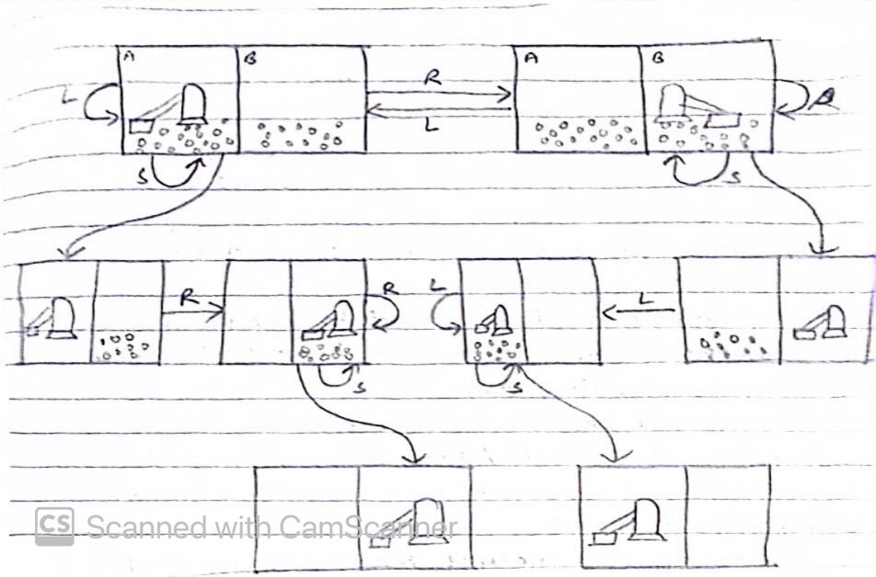
Vacuum cleaner example for illustrate how the problem can be formulated using the Goal Formulation approach
States: There are two states given A and B which are either dirty or not dirty
Initial State: Any state can be initial state
Actions: the actions can be moving left, moving right, and suck dirt
Goal test: Check whether the locations are clean or not
Path cost: Number of actions that takes to complete the goal
Total number of states: 8

Slide 7
03
Question 03
(AI)

Slide 8
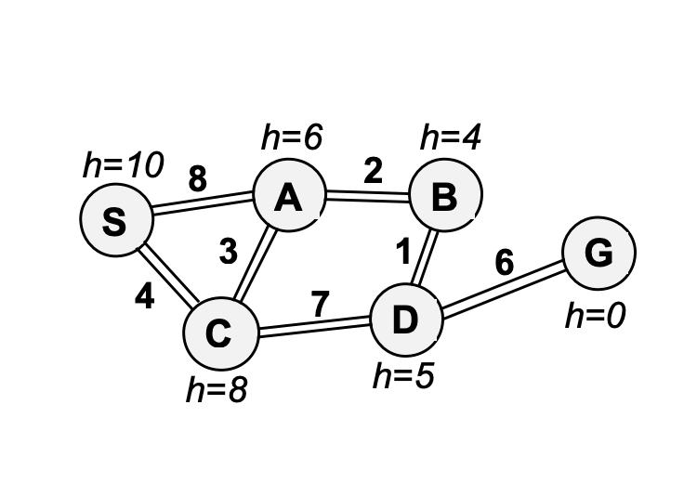
Undirected graph
07

Slide 9
Depth First Search
DFS looks down for the deepest root of the graph taking the leftmost child of the root note.
Algorithm:
Put the start node on the stack
While the stack is not empty;
Pop the stack
If the top of the stack is the goal, then stop
Otherwise push the node connected to the top of the stack provided, which are not in the stack

Slide 10
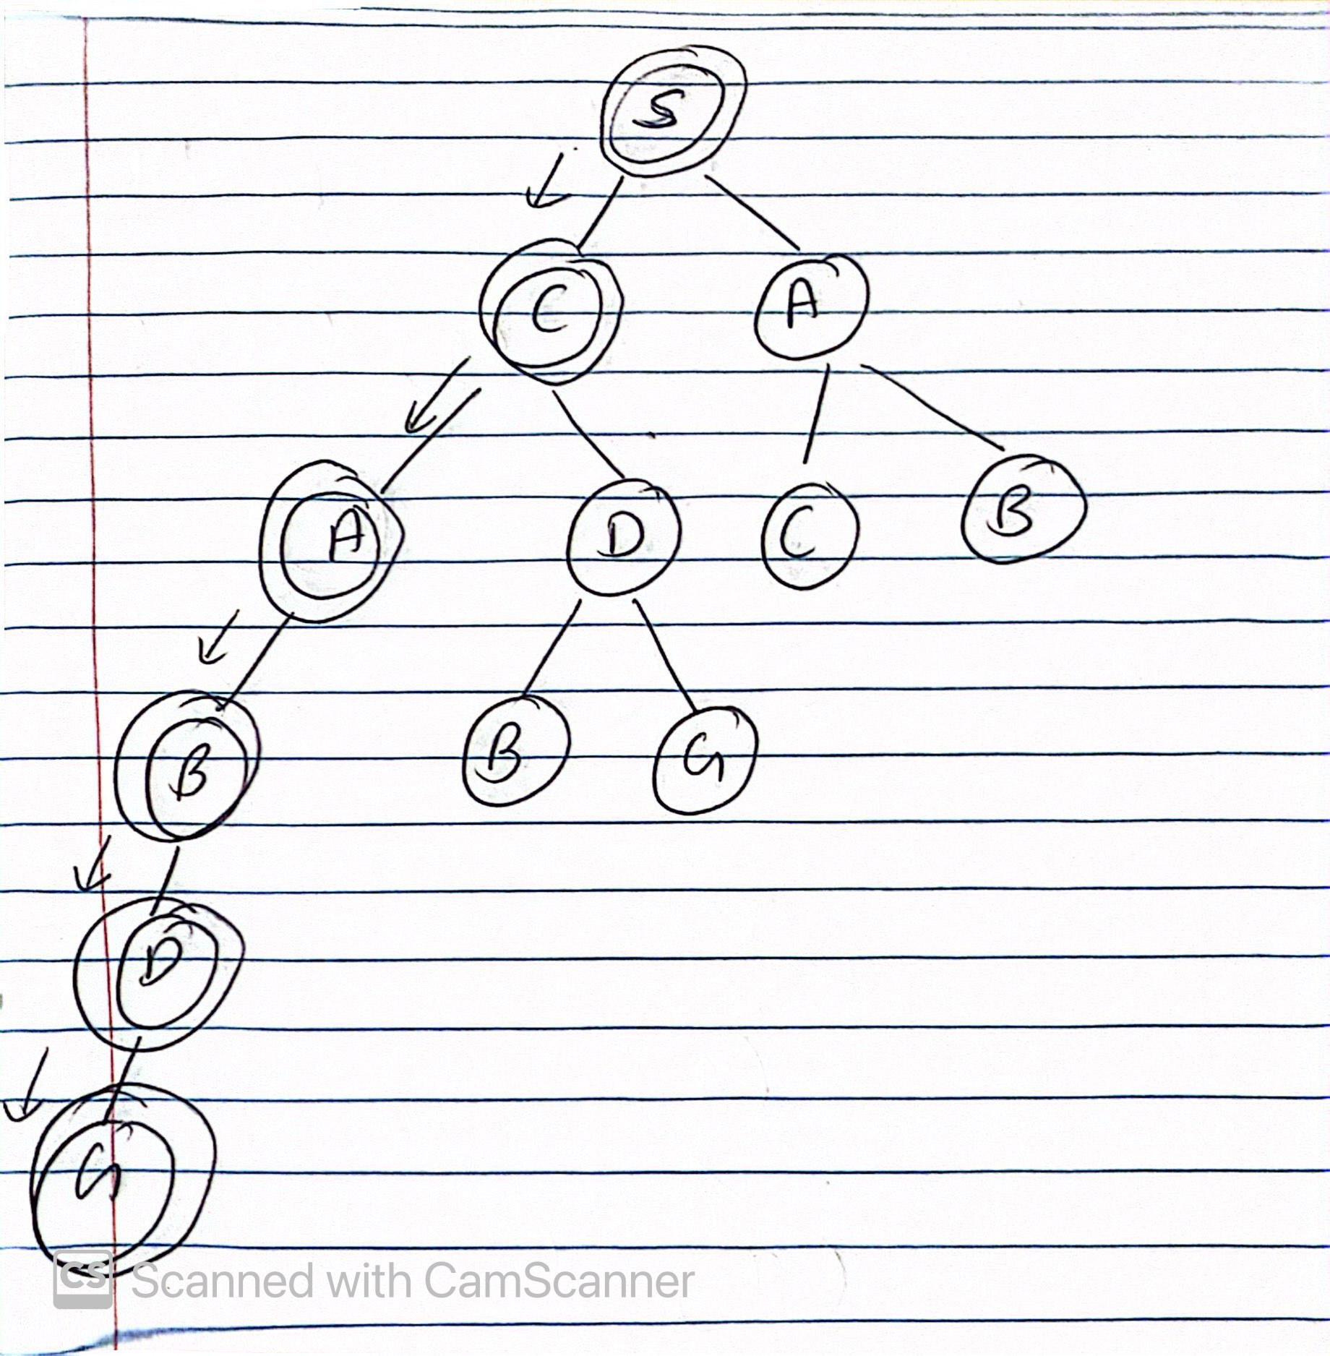
Firstly, we created a tree out of the undirected graph;
Initial node ‘S’, is not a goal node
then, we check child nodes of S, we have A and C, we take ‘C’ as it is on the left node
Check If C is a goal node, C isn't a goal node, we again check child nodes of C, we have A and D. we choose A as it is a left node
Check If A is a goal node, A isn't a goal node, we again check child nodes of A, we have B
Check If B is a goal node, B isn't a goal node, we again check child nodes of B, we have D
Check If D is a goal node, D isn't a goal node, we again check child nodes of D, we have G.
Check If G is a goal node. Yes, G is a goal node.
The pathway from S to G are S -> C -> A -> B -> D -> G

Slide 11
Iterative Deepening Depth First Search
Iterative Deepening DFS takes ideas of Depth Limited Search, but it iteratively increases its depth limit unless the algorithm reaches to its goal node.
Algorithm:
Starting depth limit: limit = 0, iteratively increase the depth limit performing a depth limit search for each depth limit
Stop if no solution is found, or if the depth limited search failed without cutting off any nodes because of depth limit.

Slide 12
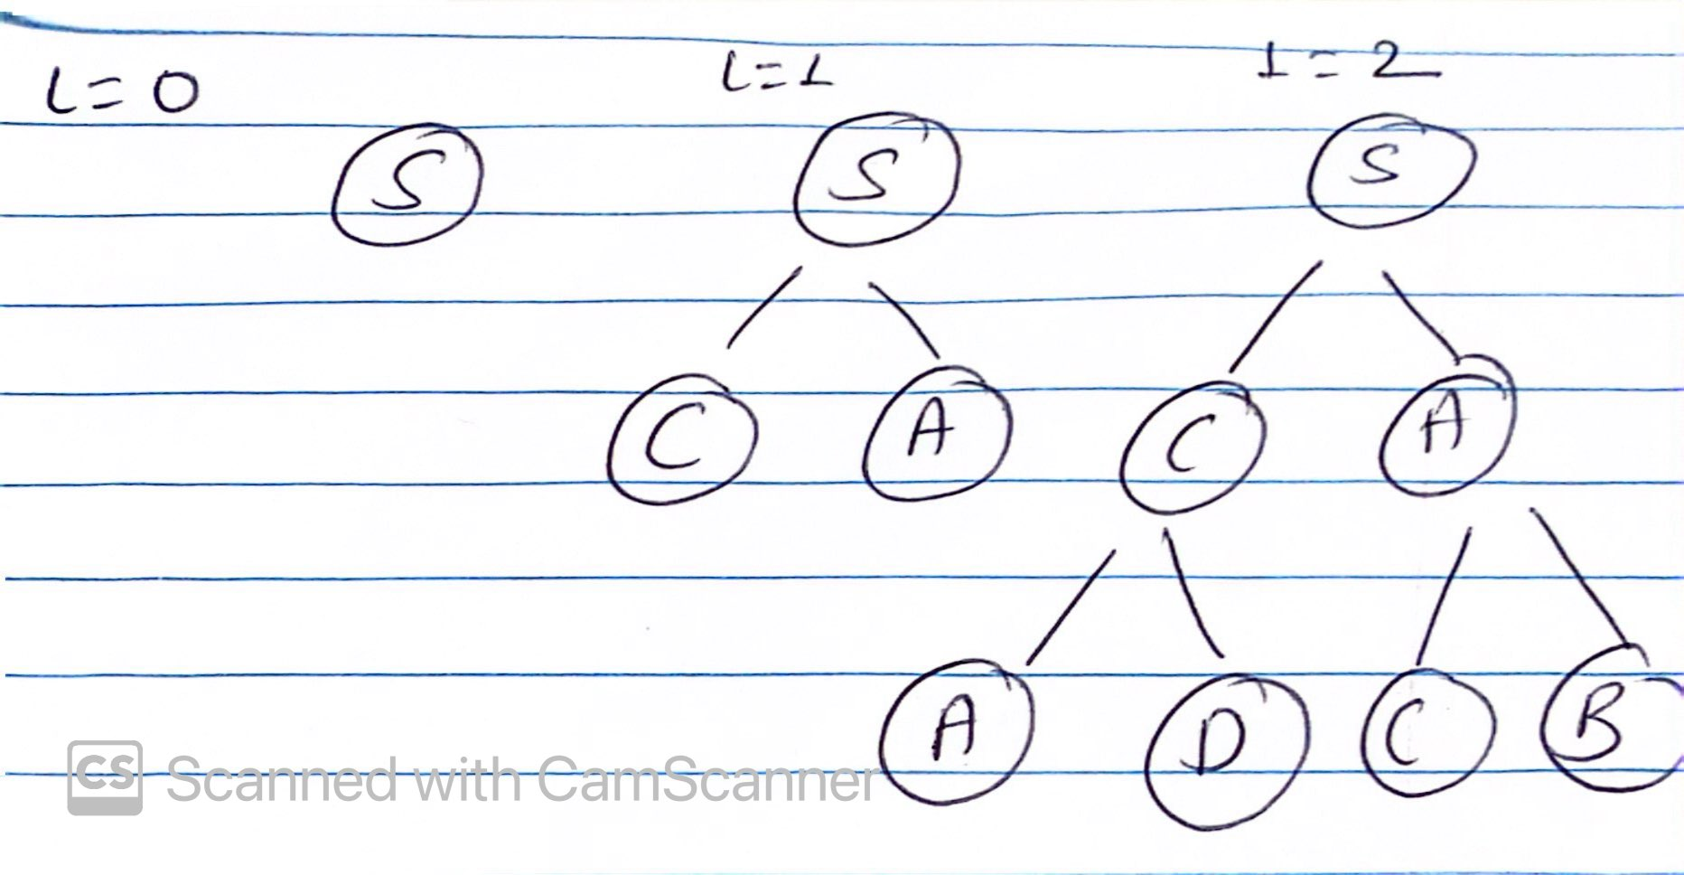
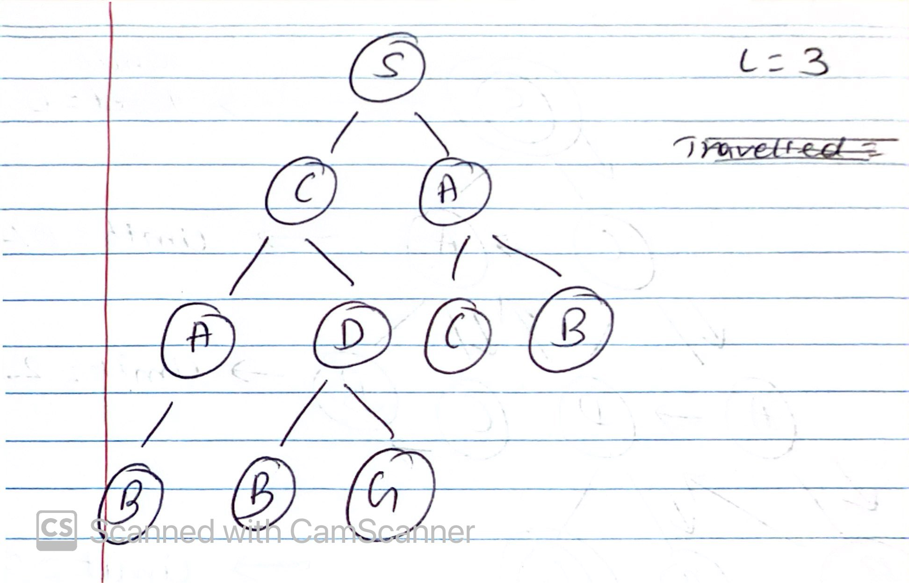
Initial State limit = 0, Visit node S, No goal node found
Increase limit = 1, perform DFS, visited nodes: S,C,A. No goal node found
Increase Limit = 2, perform DFS, visited nodes: S, C, A, D, A, C, B. No goal node found.
Increase limit = 3, perform DFS, visited nodes: S, C, A, B, D, B, G Goal node “G” found. Stop iteration. Stop Algorithm.

Slide 13
A* search
Algorithm
We use a formulae i.e. f(n) = g(n) + h(n), where
g(n) – root to node (n)
Node n to goal node
Use the formulae select the smallest last node and continue until the goal node is found in a less cost

Slide 14
Example of A* search
Step 01 – Initially select source Node
f(S) = g(S) + h(S)
= 0 + 10 = 10
Step 02 – Expand S and select Node with Minimum value of f(n)
for node A; for node C;
f(A) = g(A) + h(A) f(C) = g(C) + h(C)
= 8+6 = 14 = 4 + 8 = 12

Slide 15
Example of A* search
Step 04 – Select node C to expand and select Node with Minimum value of f(n)
for node A; for node D;
f(A) = g(A) + h(A) f(D) = g(D) + h(D)
= 4+3+6 = 13 = 4+7+5 = 16
Step 05 – Select node A to expand and select Node with Minimum value of f(n)
for node B;
f(B) = g(B) + h(B)
= 4 + 3 + 2 + 4 = 13

Slide 16
Example of A* search
Step 06 – Select node B to expand and select Node with Minimum value of f(n)
for node D;
f(A) = g(A) + h(A)
= 4 + 3 + 2 + 1 + 5 = 15
Step 07 – Select node A (because A has the least f(n) )to expand and select Node with Minimum value of f(n)
for node B; for node C;
f(B) = g(B) + h(B) f(C) = g(C) + h(C)
= 8 + 2 + 4 = 14 = 8 + 3 + 8 = 19

Slide 17
Example of A* search
Step 07 – Select node B to expand and select Node with Minimum value of f(n)
for node D;
f(D) = g(D) + h(D)
= 8 + 2 + 1 + 5= 16
Step 08 – Select Node D where f(n) is 15 and expand and Select node with minimum value of f(n). We found the goal node G. so the node traversals are S -> C -> A -> B -> D -> G
The total cost for the traversal is 4 + 3 + 2 + 1 + 6 = 16 units

Slide 18
04
Question 04
(AI)

Slide 19
Depth First Search Code explained
10
Create a Node Class with its attributes like expand, child node and path
Expand function visits all the possible child nodes of a node
Child Node returns a new node
Path constructs the path from the start node to the current node by traversing back through parent link of each node
depth_first_search function has initialization frontier and ‘explored’ as to mention it as visited
Has a while loop as long as there is a frontier, and check if it’s a goal or not
Add current Node to explored and return the path, return None is frontier empty

Slide 20
A* search code explained
10
Initialization - The function initializes open_set with a tuple holding the start node's heuristic cost to the goal, its actual cost (g=0 initially), the start node itself, and its path. An empty visited set tracks explored nodes
Loop continues as long as there are nodes in the open_set, which follows this formulae f = g + h, selects the lowest estimated cost and mark it as visited
Expand the nodes which are lowest f(n) value and then continues until the goal is not been found

Slide 21
05
Question 05
(AI)

Slide 22
Building an Expert System
12
This is a simple expert system which I have made. Please follow the link below:
https://www.mcgoo.com.au/esbuilder/viewer/viewES.php?es=c2c499376045d49f772b81cc9f4baa53

Slide 23
Terms of artificial intelligence
13
(g) Learning Based Agent
To build learning machines and then to teach those machines different scenarios. The agent is allowed to operate in initially unknown environment and then to become more competent than its initial state. Example: Email Spamming filter, which learns from user feedback on distinguishing the spam or not spam emails (Jacques, 2019)

Slide 24
06
Question 06 Building Recommendation System using 6 phases of building an intelligent knowledge-based system
(AI)

Slide 25
(a) Access the problem
Build a recommendation system that suggests personalized products to users based on their preferences and behavior.
14
(c) Develop a Prototype System
Select a suitable recommendation algorithm such as collaborative filtering, content-based filtering, or hybrid approaches.
(b) Acquire Data and Knowledge
Collect data on user interactions such as browsing history, purchase history, items viewed, items added to cart, and items purchased.

Slide 26
15
(d) Develop a Complete System
Experiment with advanced recommendation algorithms and techniques such as matrix factorization, deep learning, or reinforcement learning to improve recommendation quality and personalization
(f) Integrate and Maintain the System
Roll out the recommendation system to the production environment of the e-commerce platform.
(e) Evaluate and Revise the System
Compare the performance of different recommendation algorithms or strategies through A/B testing experiments with a subset of users

Slide 27
References
Manning, Christopher. Artificial Intelligence Definitions. Stanford University, Sept. 2020.
Bansall, Sahil. “Agents in Artificial Intelligence - GeeksforGeeks.” GeeksforGeeks, 6 Aug. 2019, www.geeksforgeeks.org/agents-artificial-intelligence
Pinker, Steven . “Rationality | Definition & Facts | Britannica.” Www.britannica.com, 12 July 2022, www.britannica.com/topic/rationality.
R., Lalita. Artificial Intelligence (AI). 2021, www.taylorfrancis.com/chapters/edit/10.1201/9781003005629-3/ai-vs-machine-learning-vs-deep-learning-lalitha
16

Slide 28
References
17
Gamieldien, Yasir. “Innovating the Study of Self-Regulated Learning: An Exploration through NLP, Generative AI, and LLMs.” Vtechworks.lib.vt.edu, 12 Sept. 2023, vtechworks.lib.vt.edu/items/97334c0c-9eee-464b-8a79-b3145de245de
Calvo, Rafael A., et al. “Supporting Human Autonomy in AI Systems: A Framework for Ethical Enquiry.” Philosophical Studies Series, vol. 140, 2020, pp. 31–54, link.springer.com/chapter/10.1007%2F978-3-030-50585-1_2#Sec2, https://doi.org/10.1007/978-3-030-50585-1_2.
Fleuriot, Jacques , et al. Intelligent Agents and Their Environments. 15 Jan. 2019, www.inf.ed.ac.uk/teaching/courses/inf2d/timetable/01_Intelligent_Agents.pdf
Cui, Author Chris. “How to Build an Artificial Intelligent System (I).” C. Cui’s Blog, 4 Sept. 2019, cuicaihao.com/2019/09/04/how-to-build-an-artificial-intelligent-system

Slide 29
Thanks!
Any questions?
Please, keep this slide as attribution

